Slide 1
ANALYSIS AND REPORTING SYSTEM OF BANK ACCOUNT DETAILS
By
P. Sai Priya

Slide 2
Objective
Development of a Analysis & Reporting System of Bank Account Details

Slide 3
Tools Required
SQL
SSIS
Power BI

Slide 4
Project Flow
EXTRACT
REPORTS
Heterogeneous Sources i.e. operational data (Flat files)
TRANSFORM
Data warehouse (Oracle)
Reports Based On Tool
LOAD

Slide 5
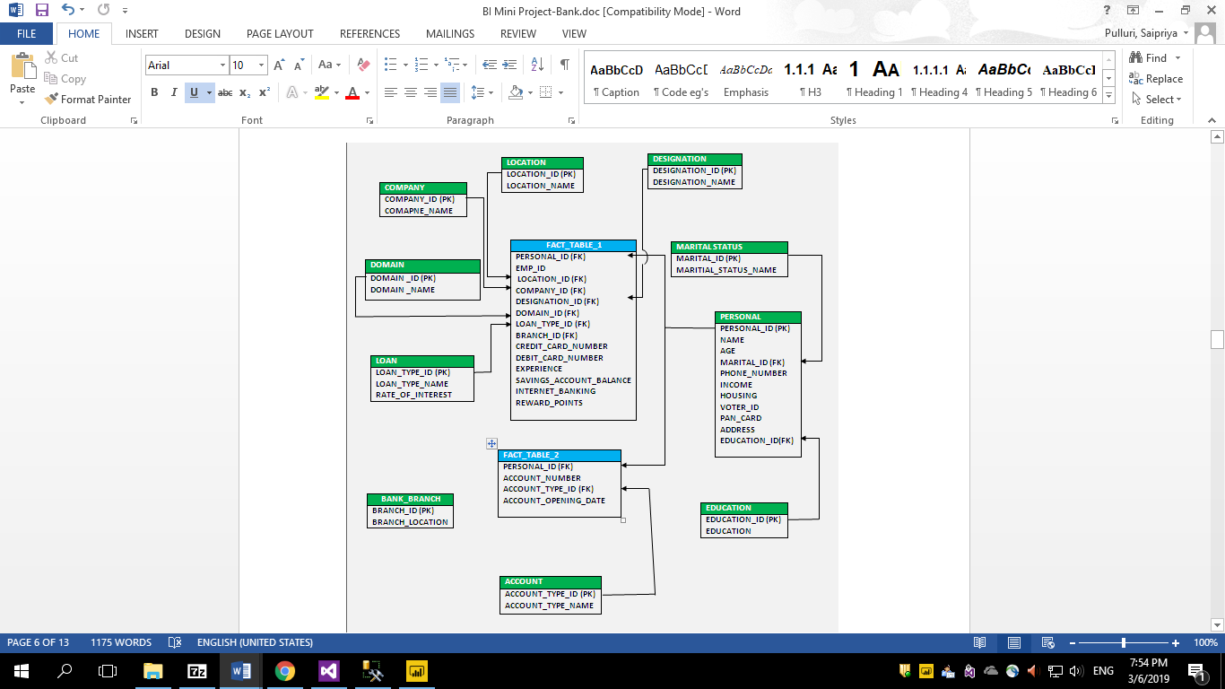
Schema

Slide 6
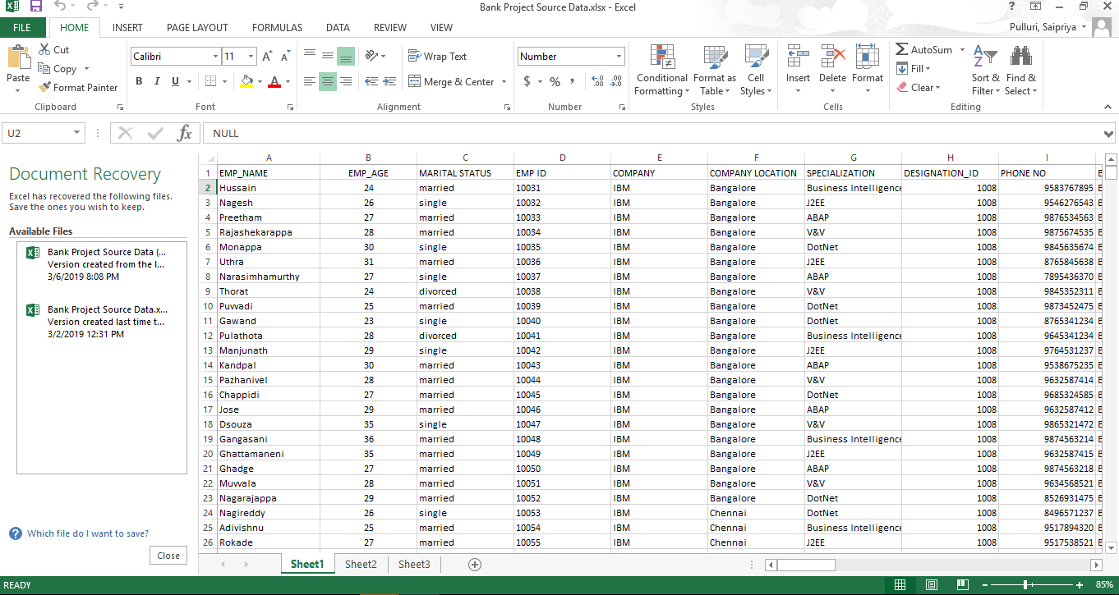
Source File

Slide 7
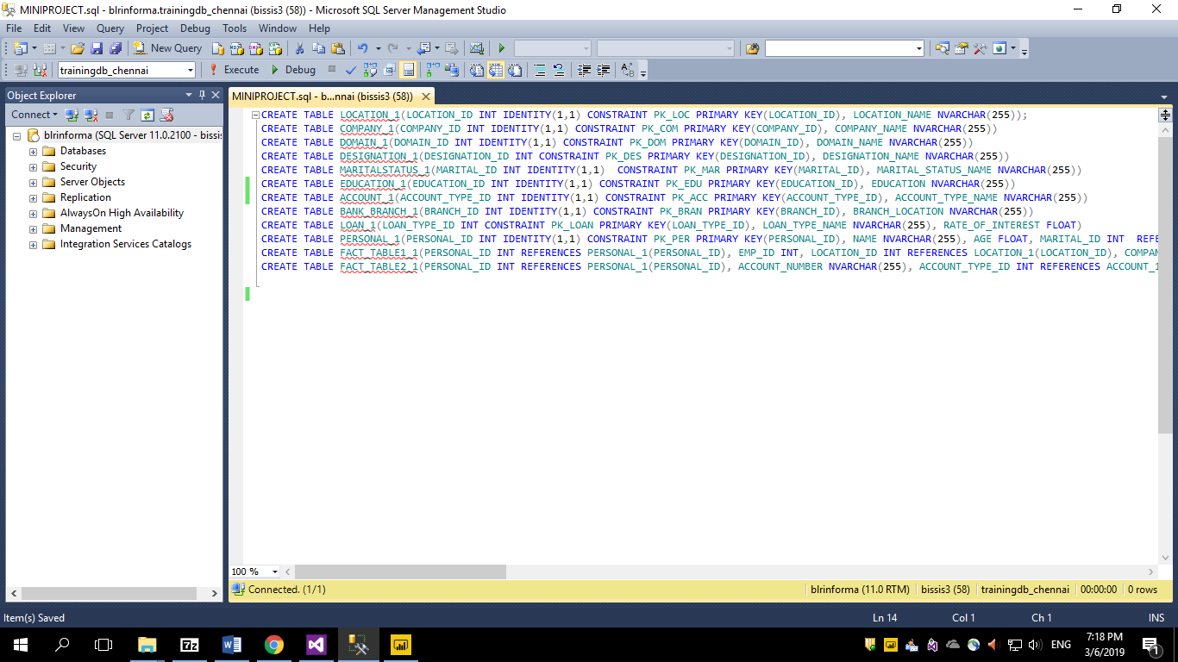
SQL Queries to Create Tables

Slide 8
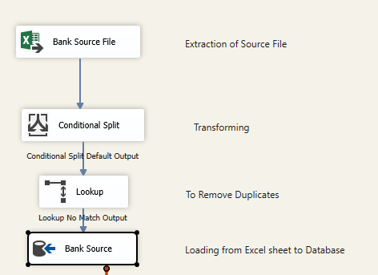
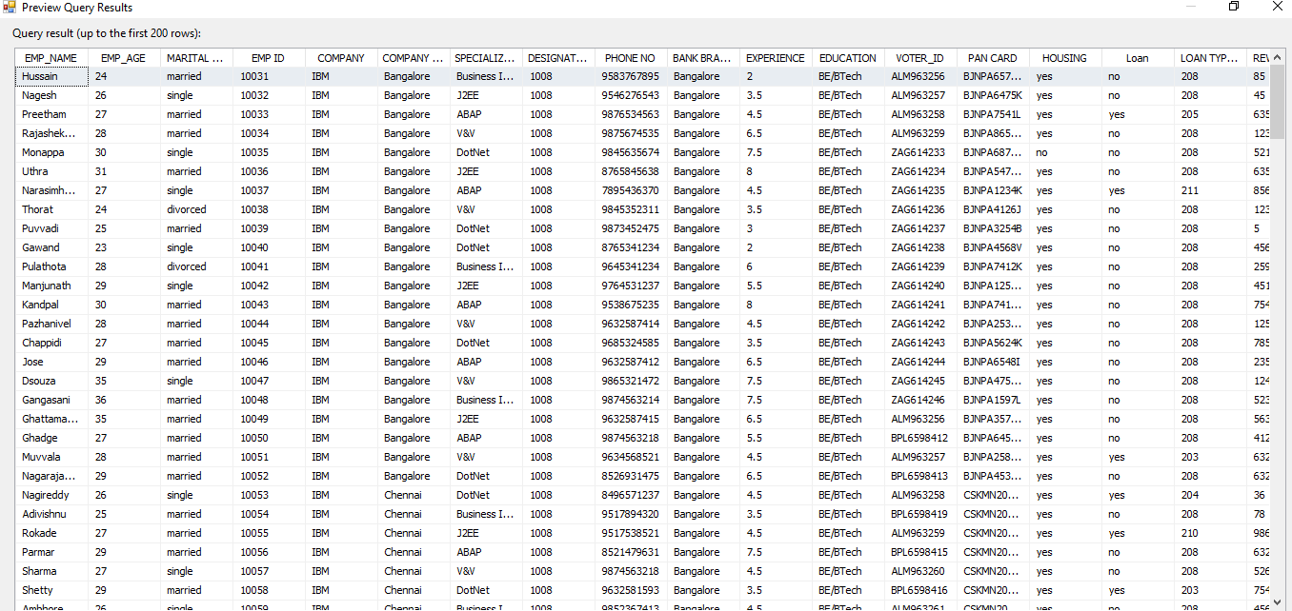
Staging

Slide 9
Dimension Tables

Slide 10
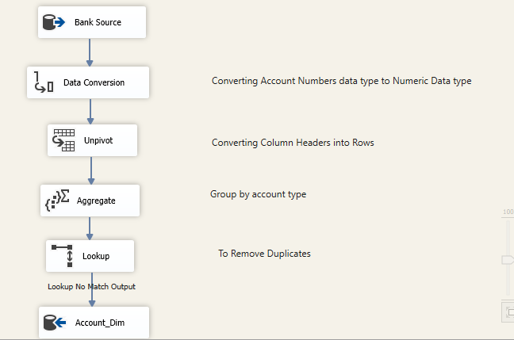
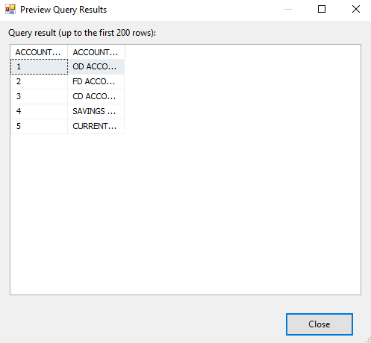
Account_Dim Table

Slide 11
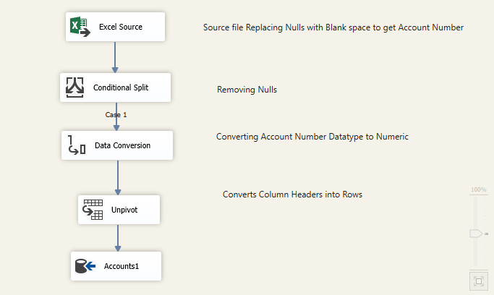
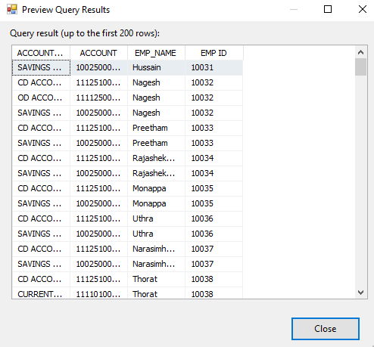
Accounts1 Table

Slide 12
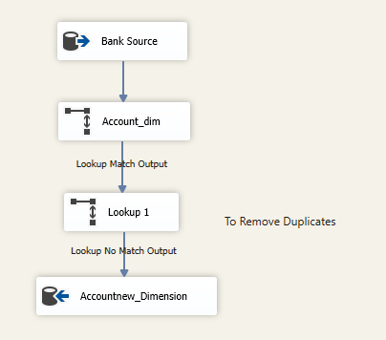
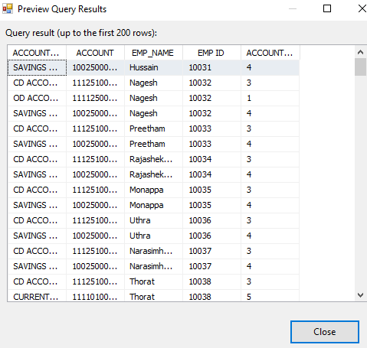
Accountnew_Dim

Slide 13
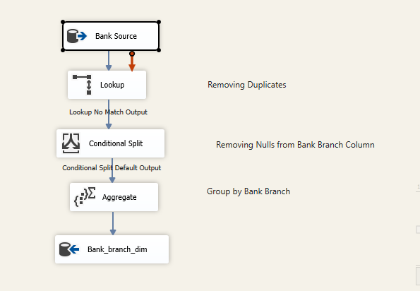
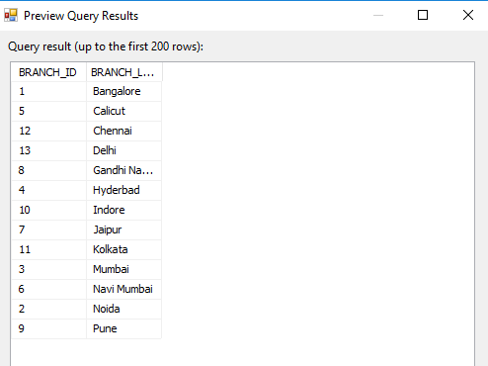
Bank_Branch_Dim Table

Slide 14
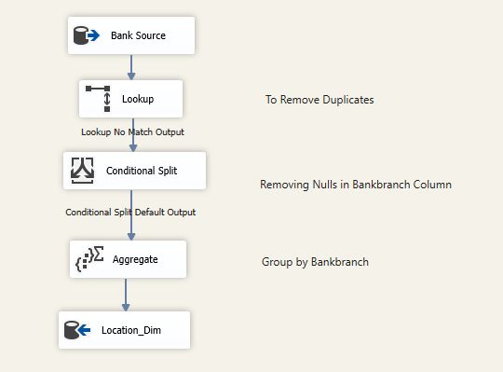
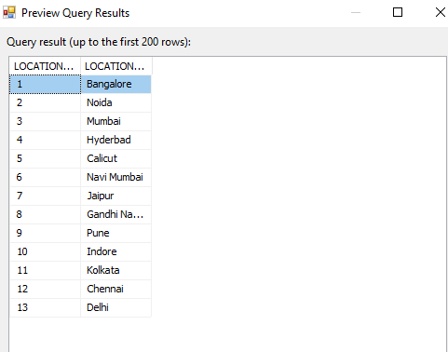
Location_Dim Table

Slide 15
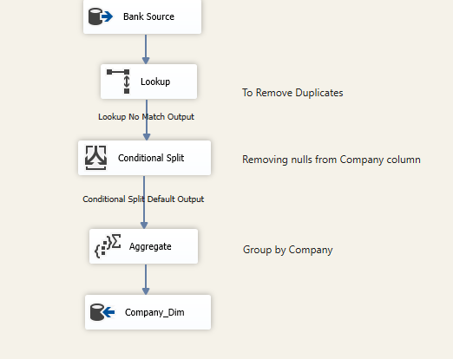
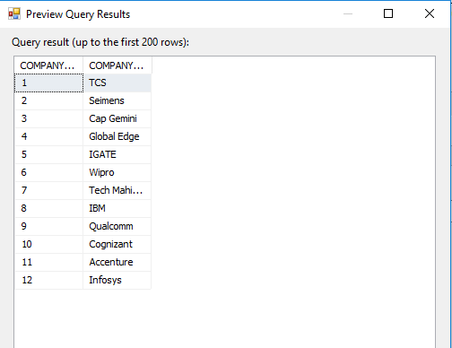
Company_Dim Table

Slide 16
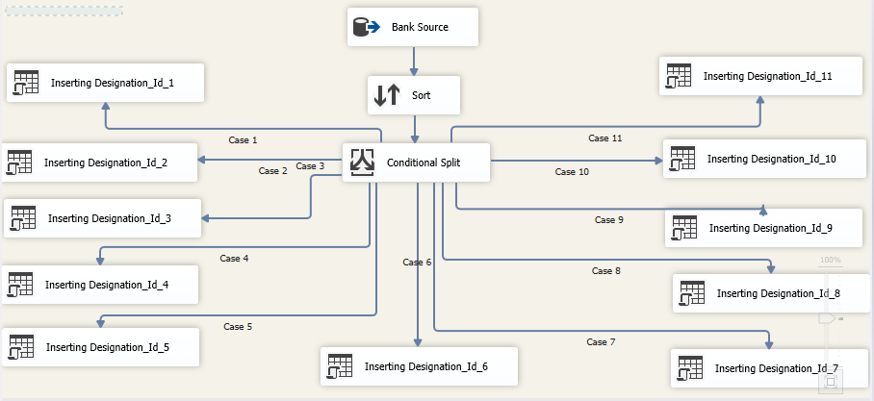
Loading Designation ID’s into Designation_Dim Table

Slide 17
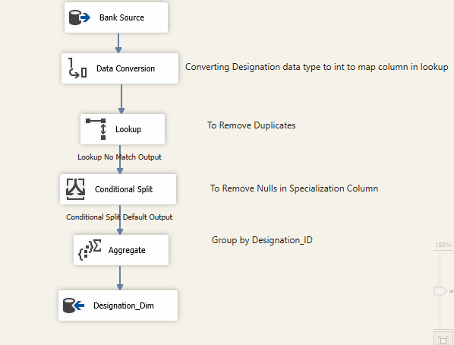
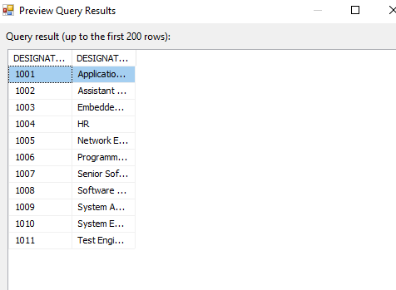
Designation_Dim Table

Slide 18
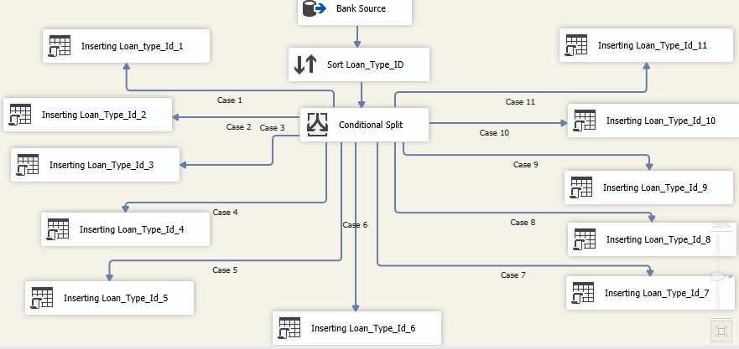
Loading Loan Type ID’s Into Loan Table

Slide 19
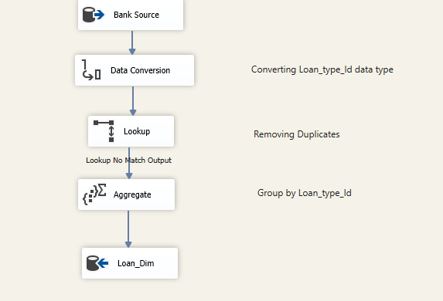
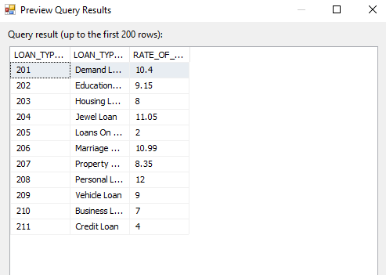
Loan_Dim Table

Slide 20
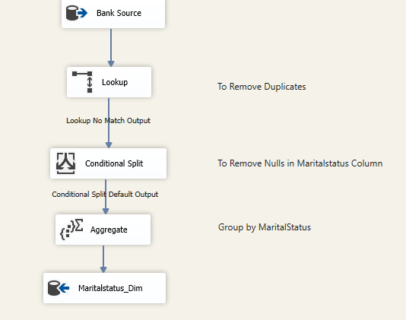
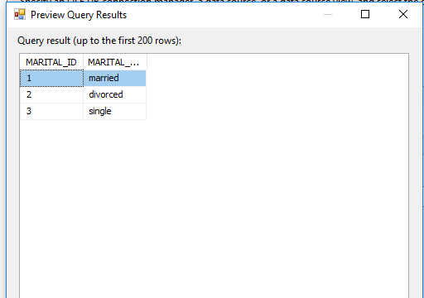
Marital_Status_Dim Table

Slide 21
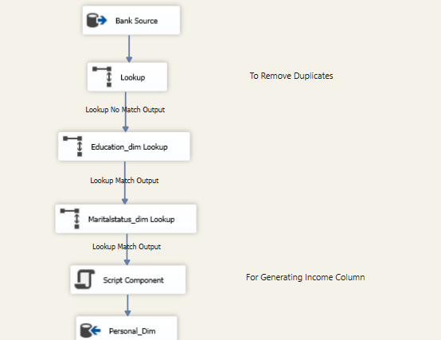
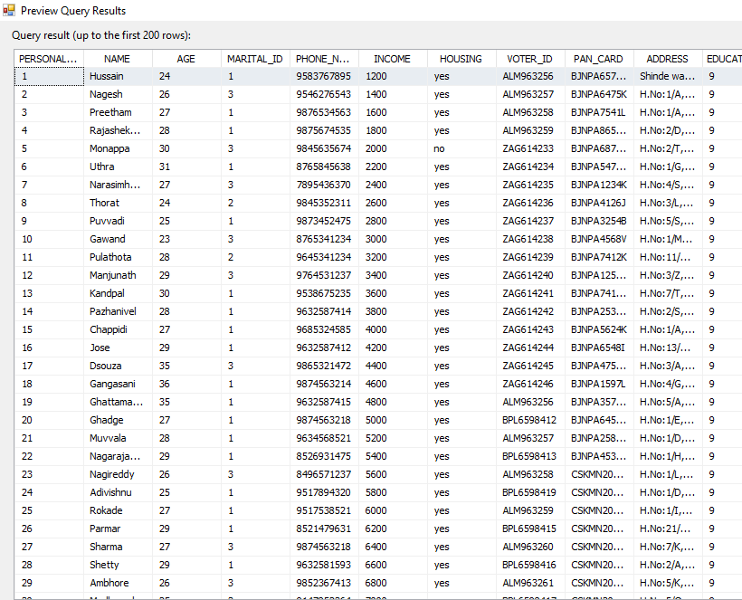
Personal_Dim Table

Slide 22
Fact Tables

Slide 23
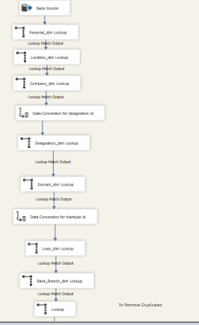
Fact Table 1

Slide 24
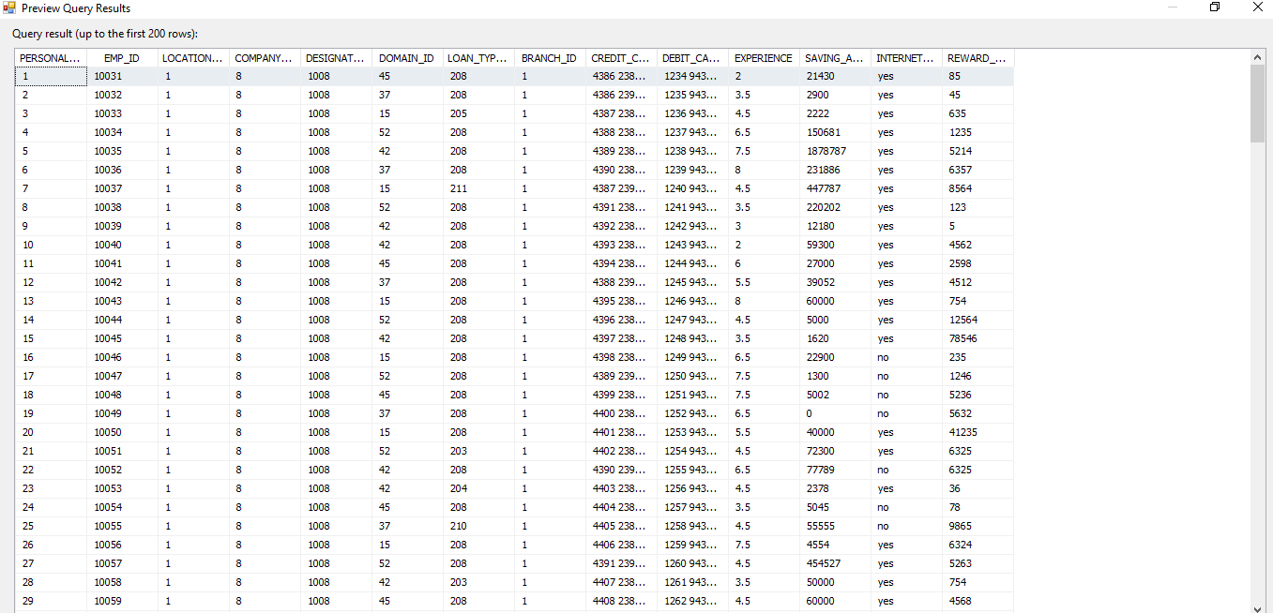
Fact_Table_1 Data

Slide 25
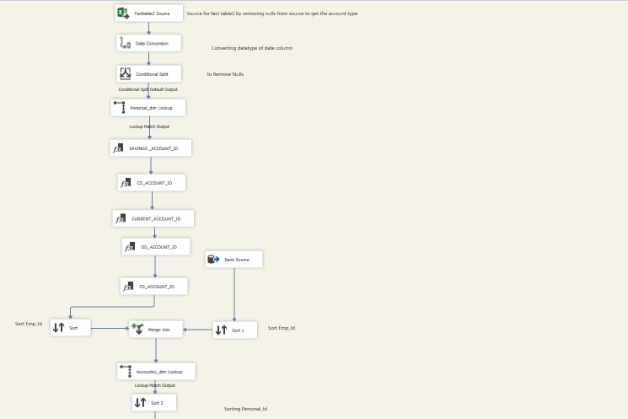
Fact Table 2

Slide 26
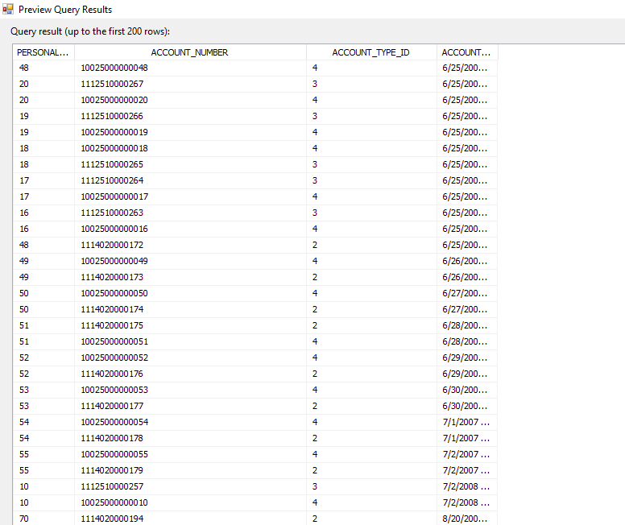
Fact_Table_2 Data

Slide 27
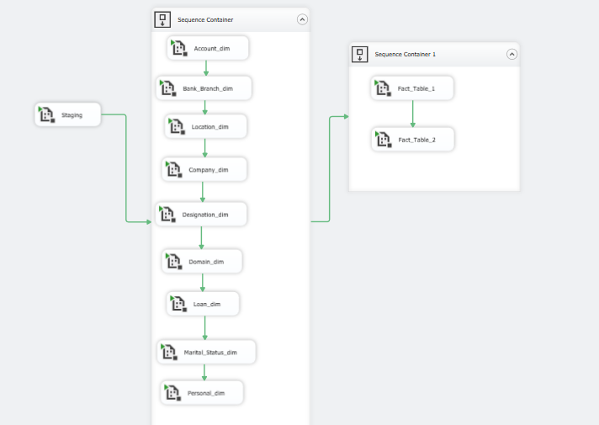
Master Package

Slide 28
Reports

Slide 29
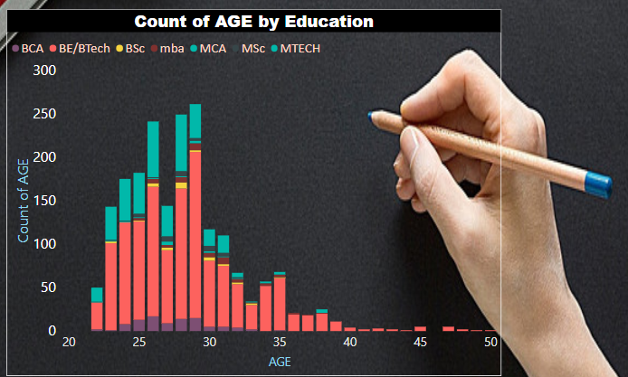
Analysis grouping on Age and Education

Slide 30
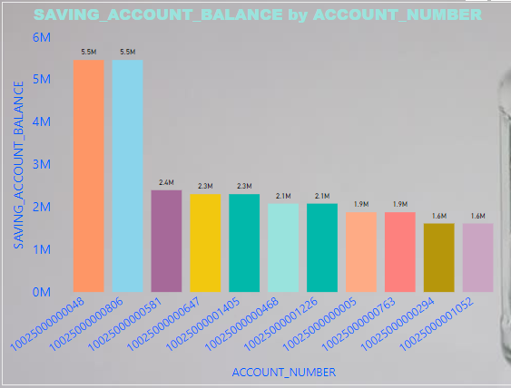
Saving Account_balance by Account_number

Slide 31
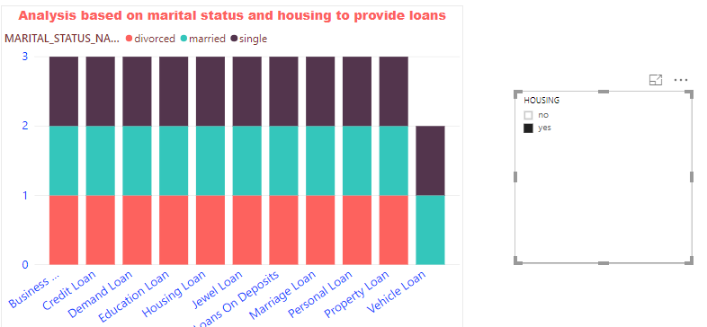
Analysis based on maritial status and housing to provide loans

Slide 32
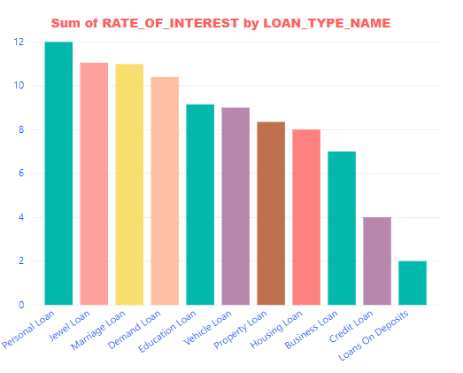
Sum of rate of interest by loan type name

Slide 33
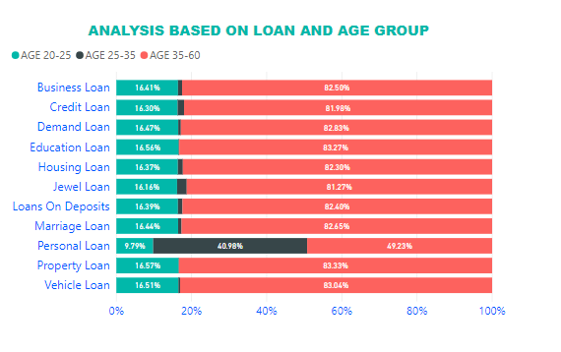
Analysis based on loan and age group

Slide 34
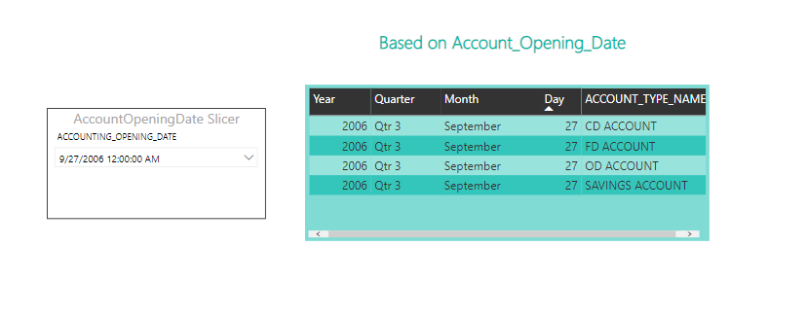
Based on Account Opening Date

Slide 35
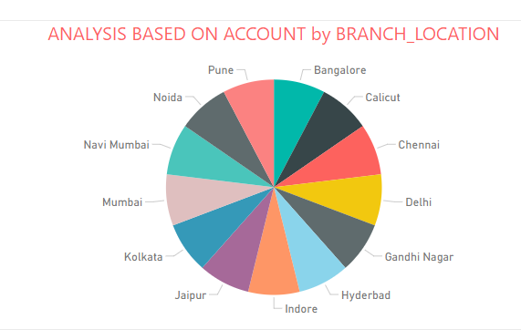
Analysis based on Account by Branch_location

Slide 36
Publishing Reports to Power BI Service and
Creating Dashboard

Slide 37
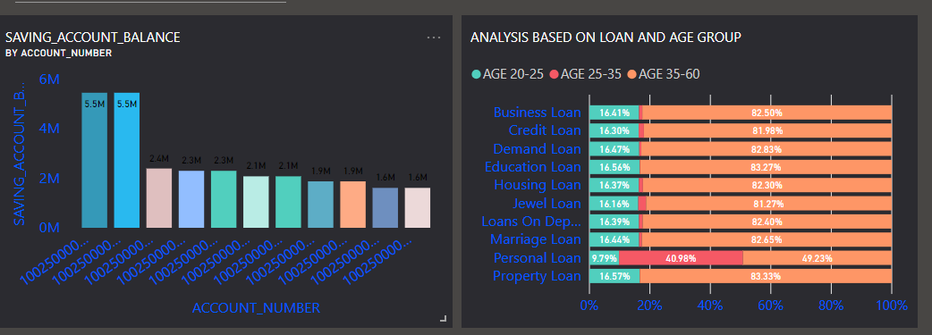
Dash Board

Slide 38
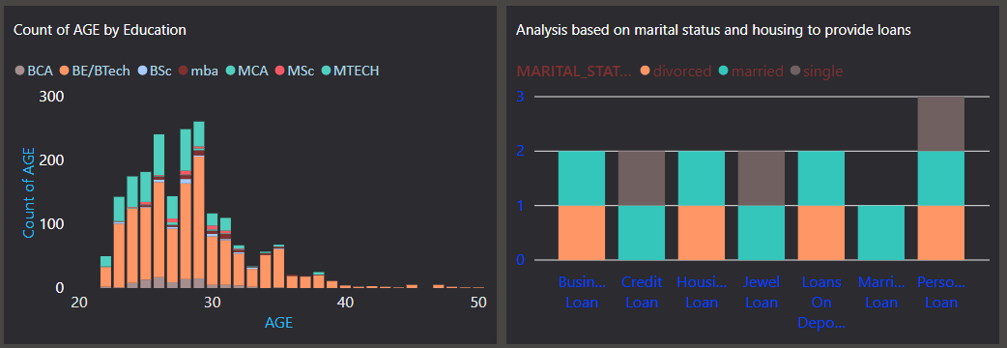

Slide 39
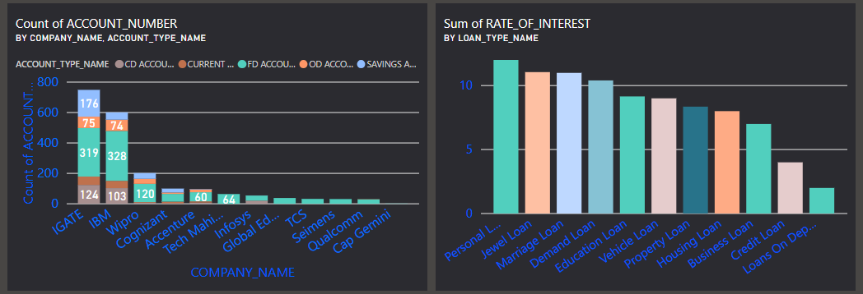

Slide 40
THANK YOU

